Slide 1
Cloud Computing and Big Data Summary and Conclusions
Oxford University
Software Engineering Programme
Nov 2015

Slide 2
Summary²
Cloud Recap
IaaS
Containers
Big Data recap
Apache Spark
NoSQL and Cassandra
Realtime Big Data
Discussion and Design Exercise

Slide 3
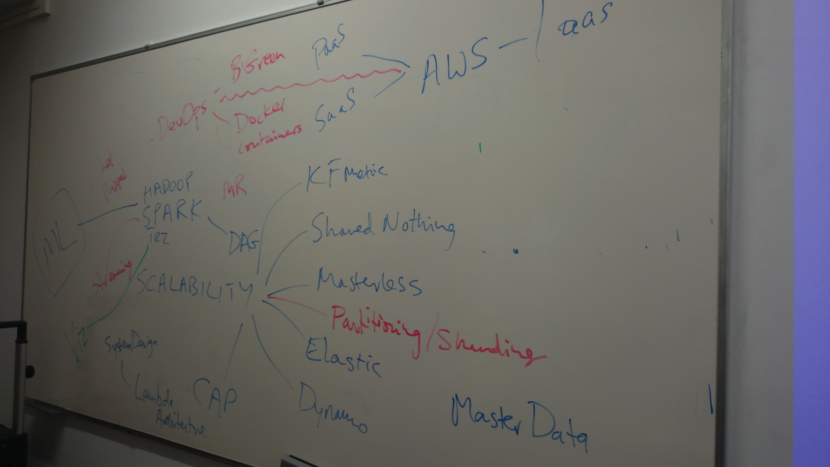

Slide 4
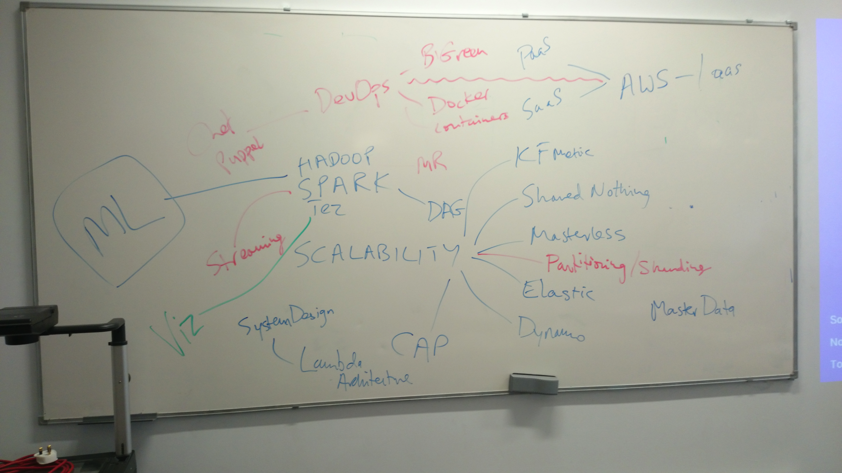

Slide 5
Questions?

